Slide 1

Products classifier
Sorrentino Alessandro, 815999
Ratti Burt, 816243
Zuccarella Stefano, 816482

Slide 2
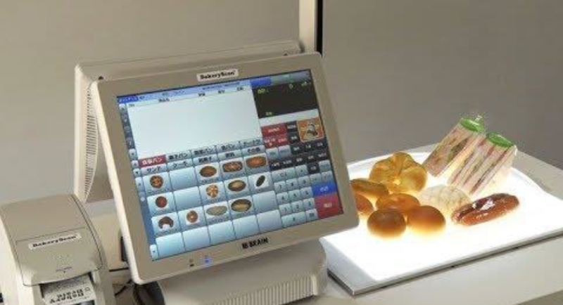
Objective
The main objective is to recognize a series of products in a given image and print the receipt.
Case of application: automated checkout registers

Slide 3
Preconditions
The images were taken from above at a constant distance d ± ε, in order to have more or less the same size for the objects.
The lighting is slightly not homogeneous because of flash (radial illumination from the center).
Objects can slightly touch other objects and they can be rotated in different ways.
Objects should have as less shadows as possible.
The background color must be homogeneous and there must not be other things besides that.
The images were taken with the photocamera Canon EOS 700D, lens 18-55 mm.

Slide 4
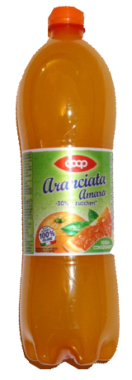
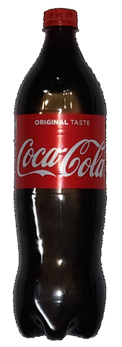
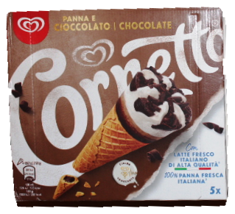
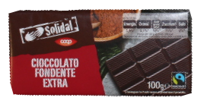
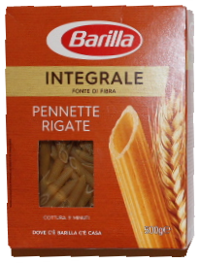
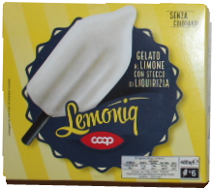
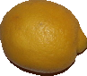
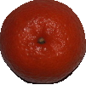
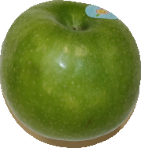
Objects to recognize /1
Cioccolato
Algida
Aranciata
Cocacola
Limone
Mandarino
Mela
Ghiaccioli
Integrale

Slide 5
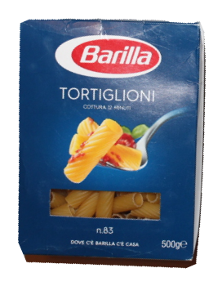
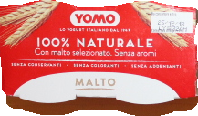
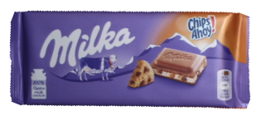
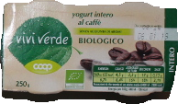
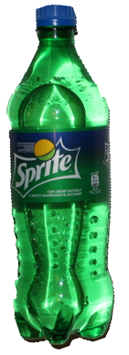
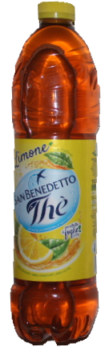
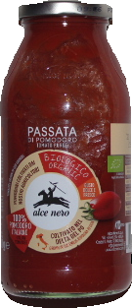
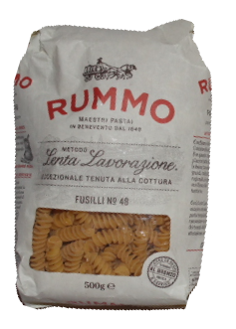
Objects to recognize / 2
Milka
Viviverde
Yomo
Pasta
Sprite
The
Passata
Rummo

Slide 6
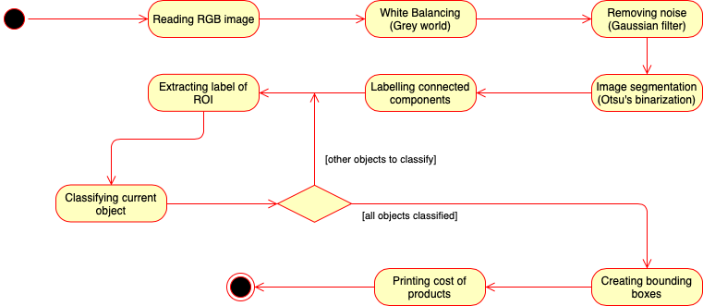
Generic pipeline

Slide 7
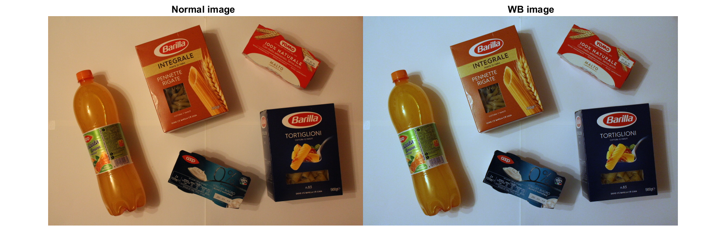
White Balancing
White balancing example using "Gray world" algorithm
Rx = Kx * X, Kx = GrayX/Xaverage, GrayX = 128 (or 0.5) ( X € {R, G, B} )
(Images have been taken using flash in order to reduce the presence of shadows and to uniform the color. This image has been taken without it to show the management for photos without flash)

Slide 8
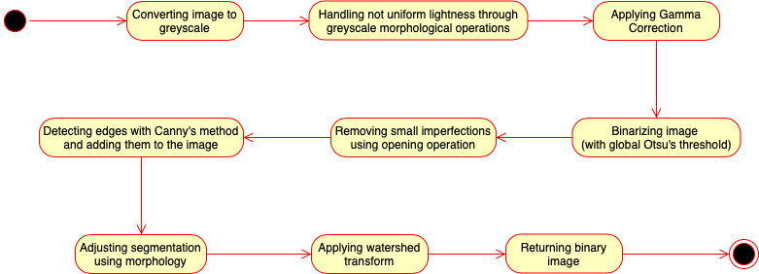

Segmentation pipeline
Other parameters:
Structuring element for morphology is a disk of size 3x3
Structuring element for background removal is a disk of size 60x60
Gamma correction: gamma = 1, low_in & high_in = 0,
Opening for imperfections: 1000(px) (Area)
Canny edge magnitude: 0.1

Slide 9
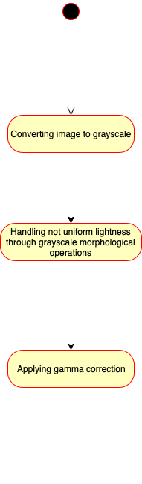
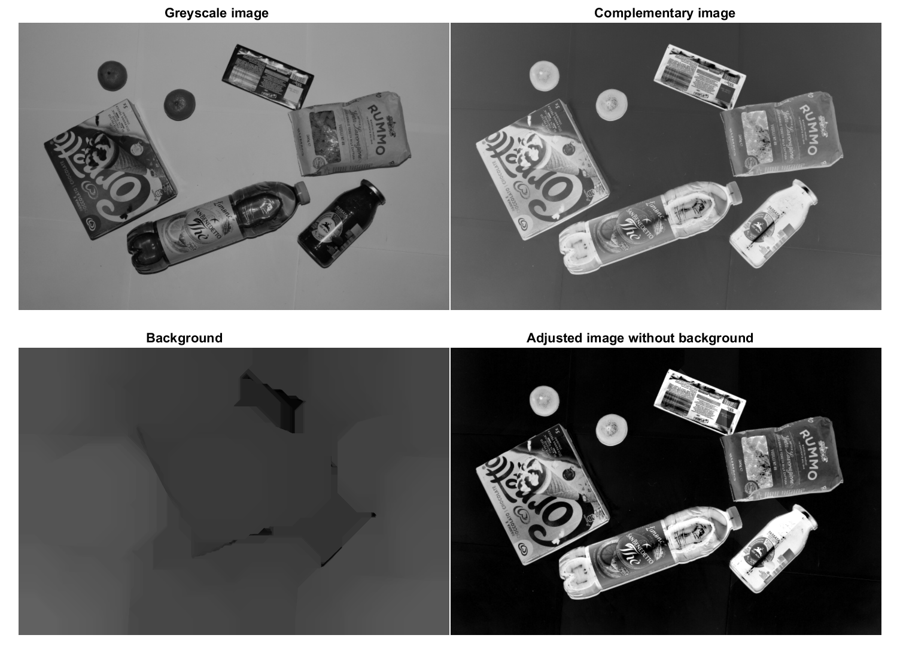
Segmentation

Slide 10
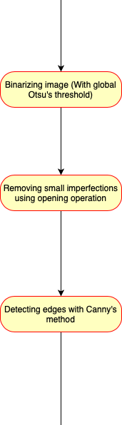
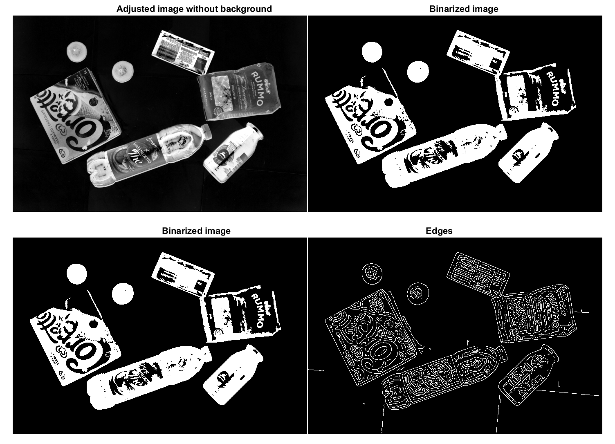
Segmentation

Slide 11
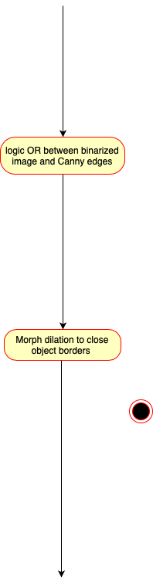
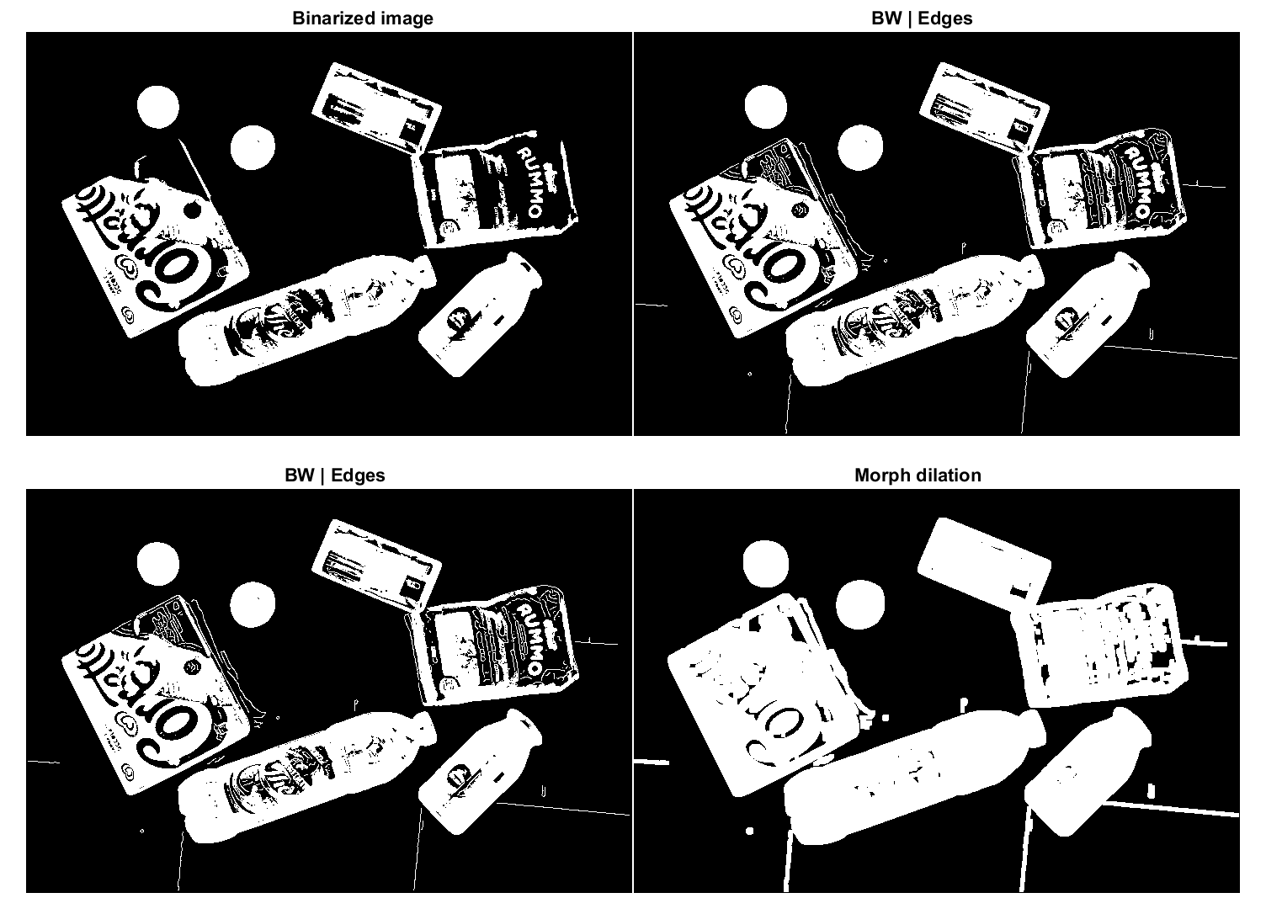
Segmentation

Slide 12
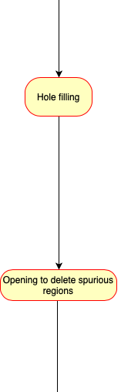
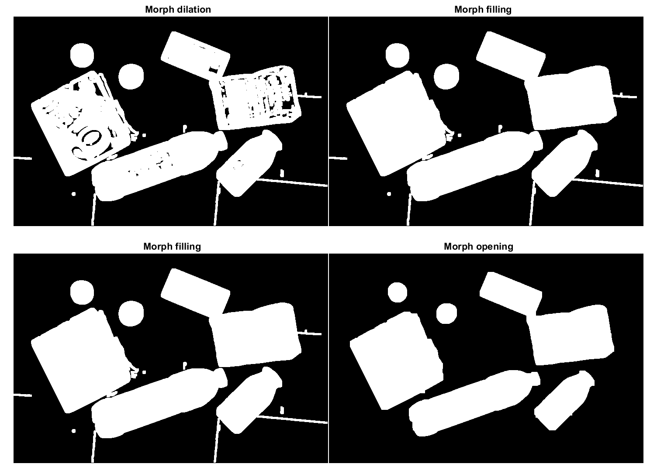
Segmentation

Slide 13
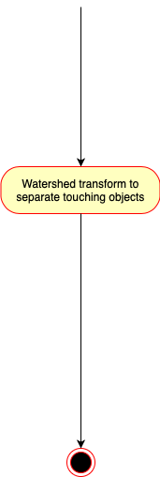
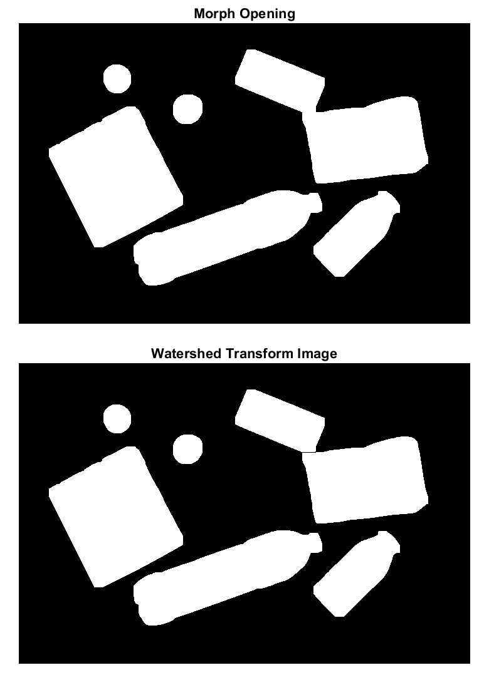
Segmentation

Slide 14
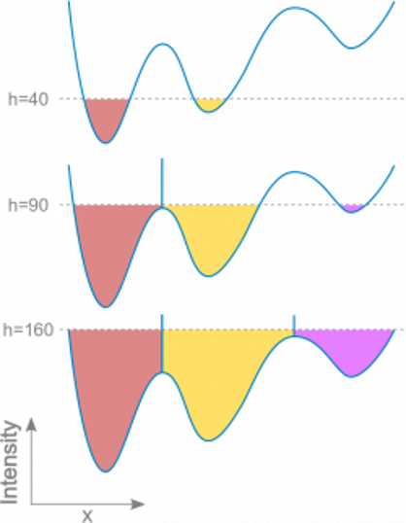
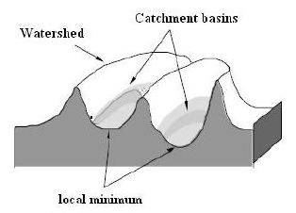
Watershed Transform
Input: Greyscale Image
The image can be seen as a topological surface, where pixel values correspond to heights.
The main idea is to flood from below (local minimum) the surface with water at a uniform rate. When two flooded regions from separate catchment basins collide, a watershed ridge is created to avoid the merger (edge):
It is especially useful for segmenting touching objects.
Output: Label Matrix -> The elements labeled 0 belong to watershed ridges, while the elements labeled with other nonnegative integers belong to the regions identified.
Parameters used:
ExtendedMinima: 7 (H-minima transform, min is not 0 anymore but starting from height H)

Slide 15
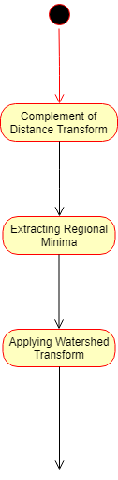
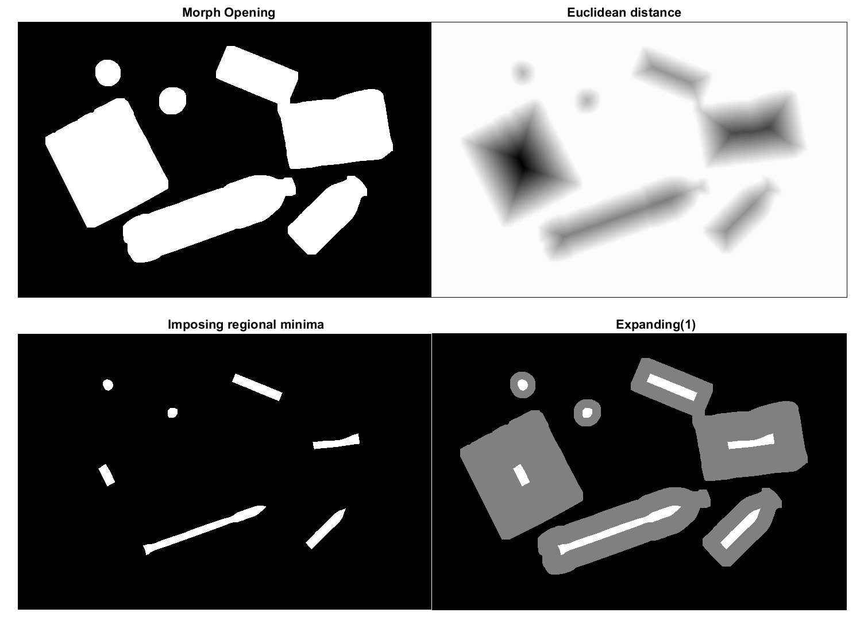
Watershed Algorithm

Slide 16
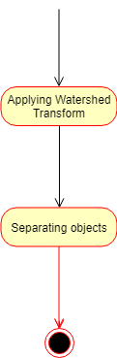
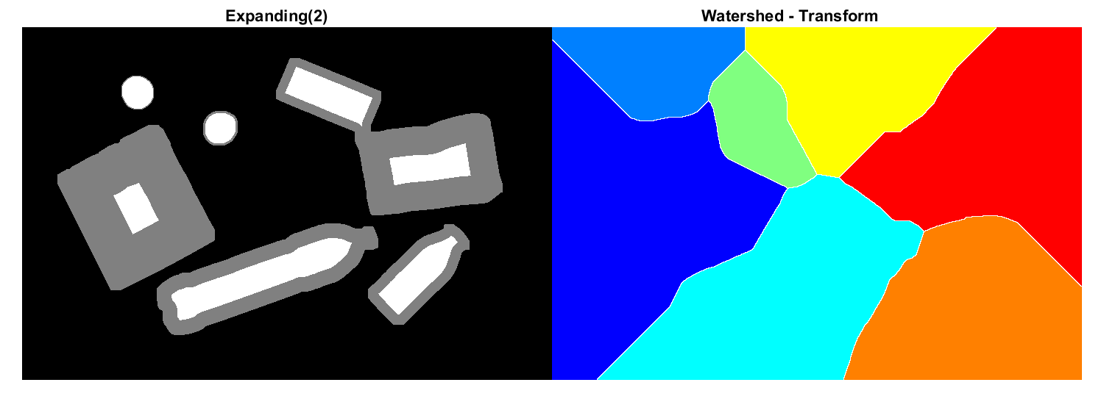
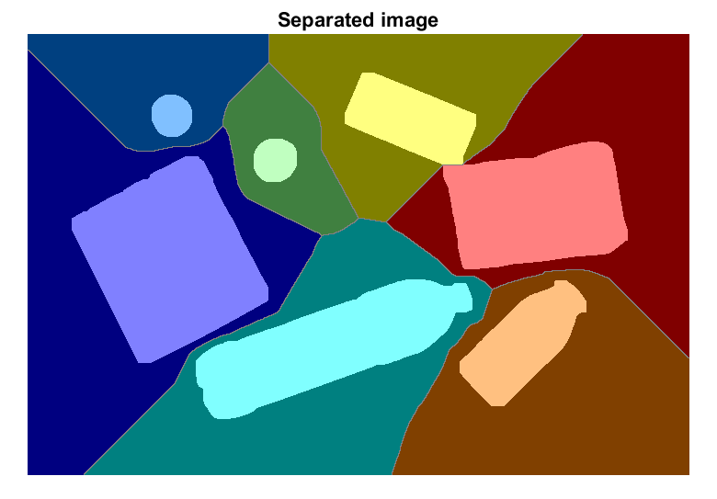
Watershed Algorithm

Slide 17
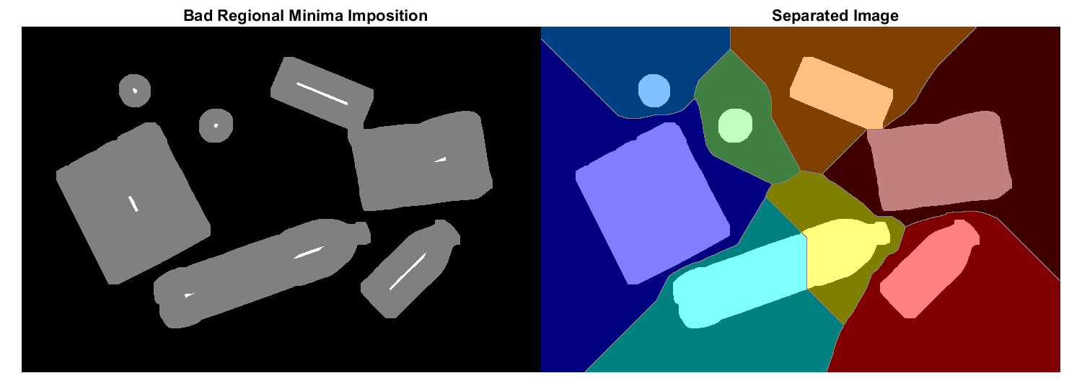
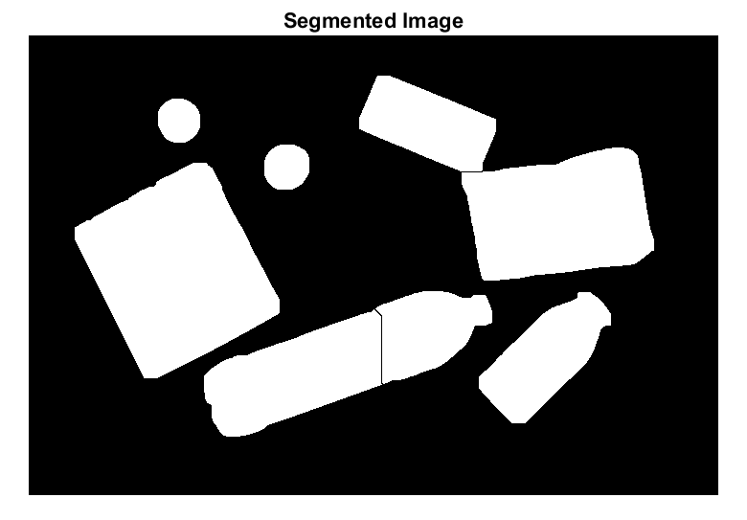
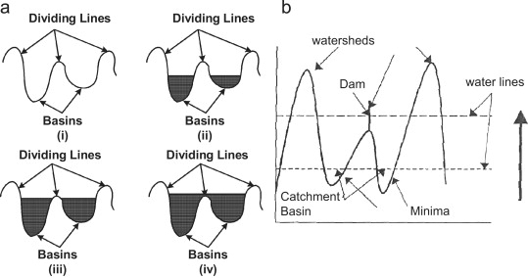
Watershed transform
Parameter for extended minima
We can see that if the H-extended minima is too low, the object is cut down in two parts. So when performing the watershed a single objects is now divided in two parts since there are two local minima inside one object

Slide 18
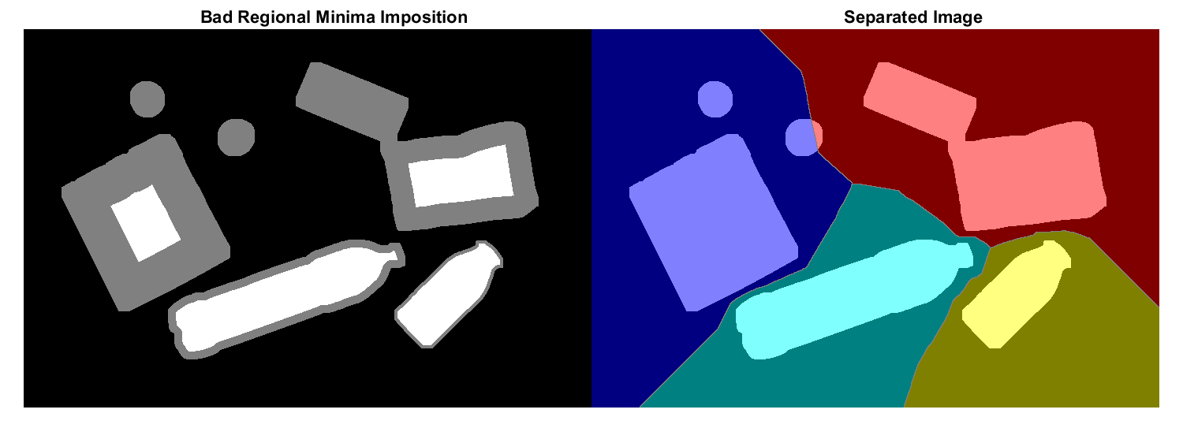

Watershed transform
Parameter for extended minima
If the H-extended minima parameter is too high, the minima of that level is too high so no minima value is found. That leads to very bad results
​

Slide 19
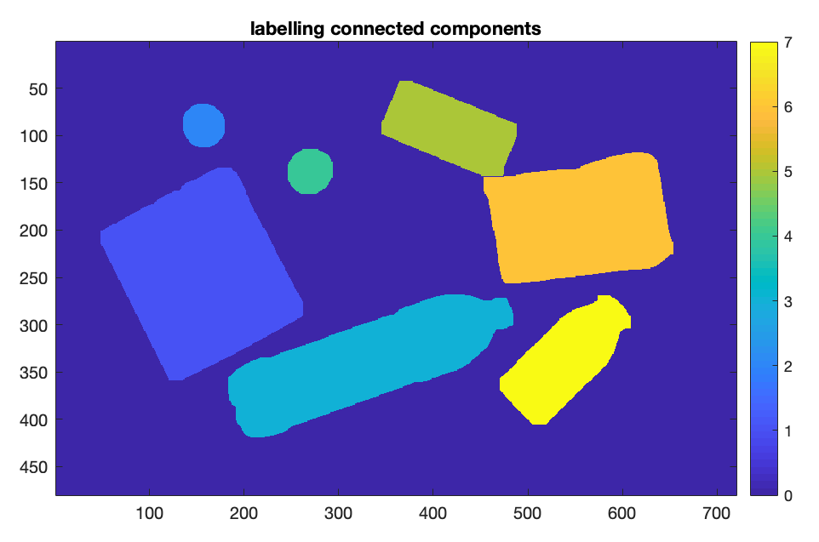
Labelling connected components
Thanks to watershed transform, touching objects are considered separated during labelling since an artificial disconnection was made

Slide 20
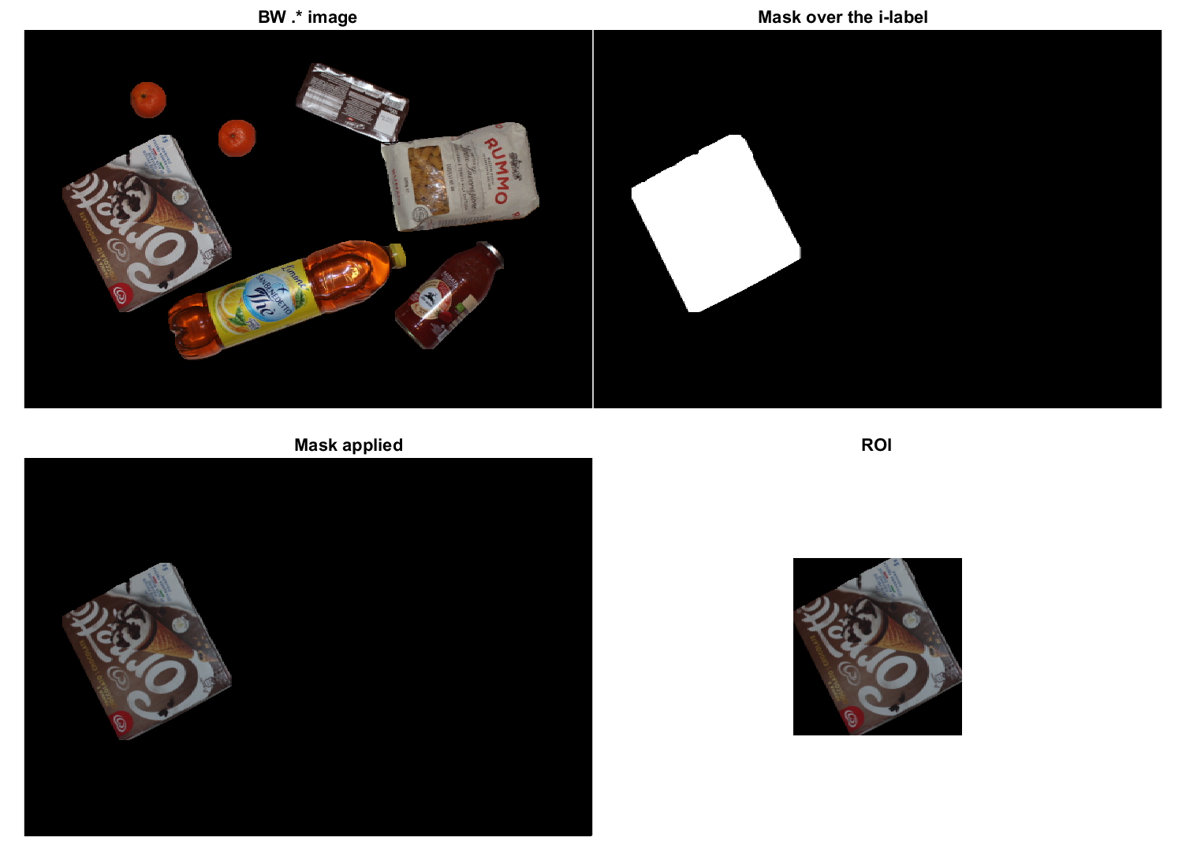
Extraction of ROI
The object is obtained by applying a mask containing the i-label to the image. Then, the ROI is detected by cropping the region of the object and passed to the classifier.

Slide 21
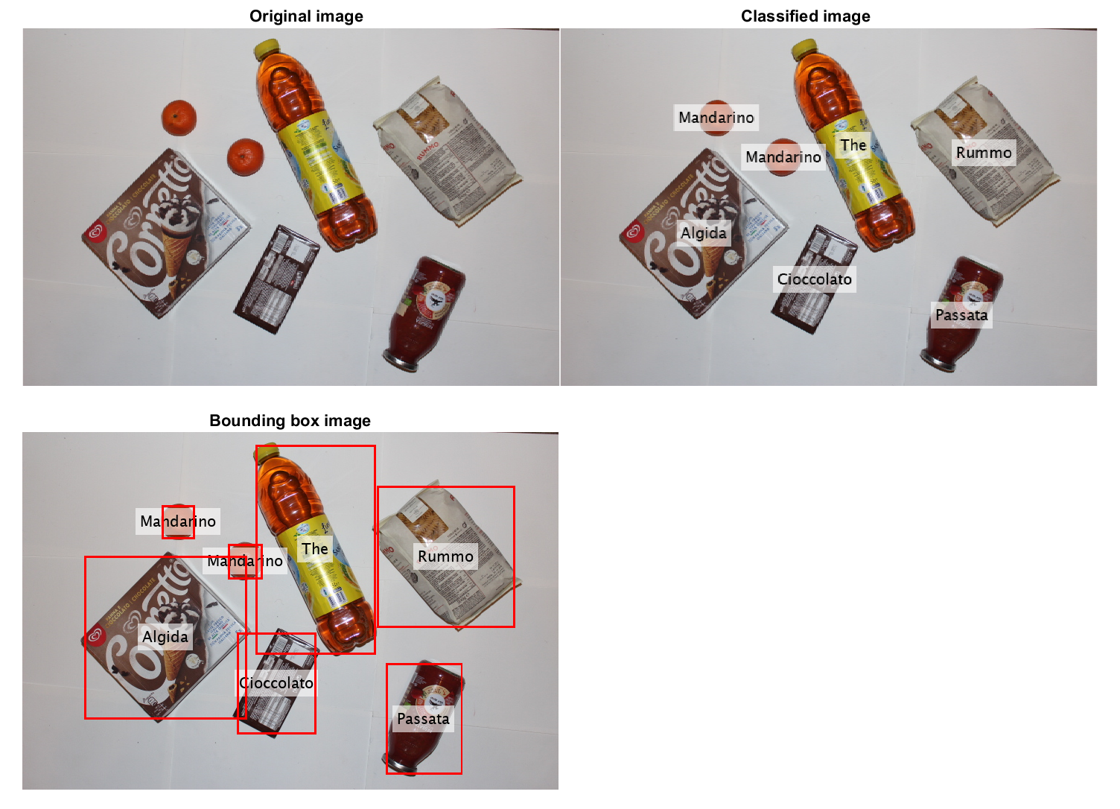
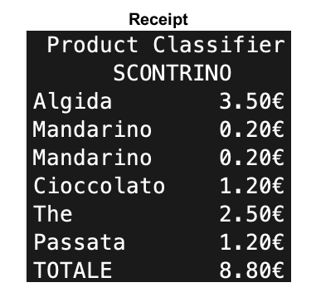
Bounding Boxes + Receipt
A bounding box is drawn for each classified product. At the end, the receipt is written, not including unknown objects.

Slide 22
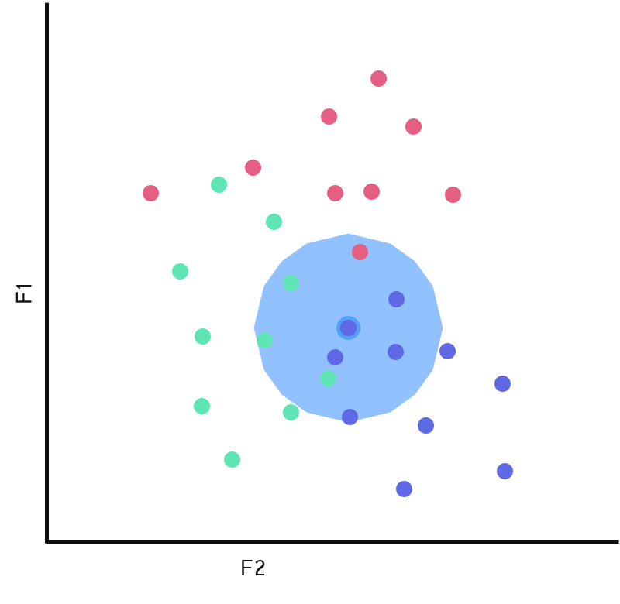


Classification
(Classificator)
We used a KNN classificator with the following parameters:
Number of neighbors: 3
Distance: 'Euclidean'
Weight on distance: squared inverse
Rejection threshold on probability:
T < 0.65

Slide 23


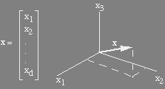

Classification
(Feature vector)
Which feature discriminates the most the objects we have in our dataset?
Shape
Color
Texture
Hu invariant moments
Compactness
Mean RGB color
CEDD
Feature vector

Slide 24


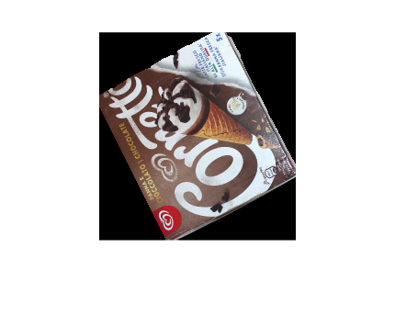



Classification
(Compactness, hu & color)
Compactness
Color
Hu moments
Describes type of shape with a numerical value.
Mean color of each channel separately (RGB)
Describes shape using central moments
Color is invariant for scale, rotation and translation
Hu moments are invariant for scale, rotation and translation
Example
Example
Example

Slide 25
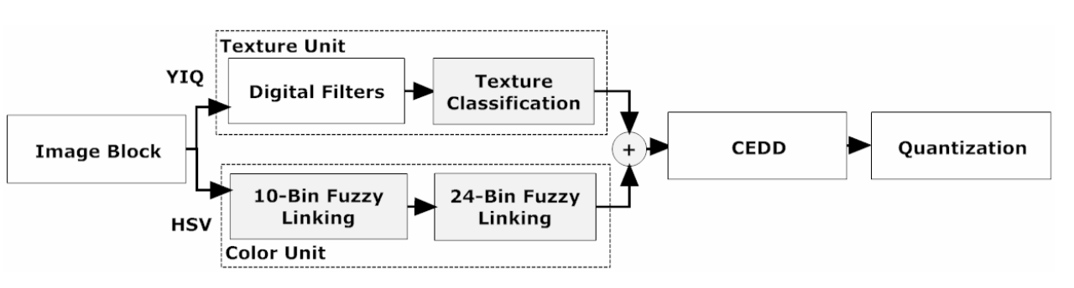

Classification
Example
(CEDD)
Calculates the Color and the Edge Directivity Descriptor (144 values)
…
Color unit
Image divided in blocks
RGB > HSV
HSV > 10 bin histogram
Black, Gray, White, Red, Orange, Yellow, Green, Cyan, Blue, Magenta
Each channel of HSV divided in fuzzy reagions (using edge info)
Multi Participate Algorithm > defuzzyfication
Second system > color divided in 3 hues > 24 bin histogram
Dark Color – Color (10 bins from before) - Light color
Defuzzification as before (each bin has number of values according to defuzzyfication algorithm)
Texture unit
Each block is divided In 4 sub blocks
Calculating edge on each sub blocks
Units combination
(vertical, horizontal, 45° diagonal, 135° diagonal, on-directional edge)​
Calculating magnitude for each block for each type of edge + normalization ( mk /max )
6 area histogram > non-edge + edge (6 bins total)
For each bins count how many edges of that type there are with thresholds value (texture classification)
Texture unit = 6 areas
Color unit = 24 areas
Total areas= 6 x 24 = 144 areas 6 areas of texture unit for each area of color unit
Normalization {0, 1}

Slide 26



Classification
(Feature vector normalization)
Normalizing each group of feature inside feature vector
Feature space using t-SNE
Feature vector
Normalized feature vector
VIVIVERDE
LIMONE
RUMMO
MILKA
GHIACCIOLI
PASTA
MANDARINO
GHIACCIOLI
ALGIDA
SPRITE
CIOCCOLATO
VIVIVERDE
INTEGRALE
MELA
COCACOLA
RUMMO
ARANCIATA
PASSATA
THE
RUMMO
PASTA
COCACOLA
THE
YOMO
MELA
CIOCCOLATO
ALGIDA
SPRITE
INTEGRALE
LIMONE
MILKA
PASSATA
MANDARINO
YOMO
ARANCIATA

Slide 27


Correct images
(ERROR)

Slide 28


Wrong images
(ERROR)
(ERROR)
(ERROR)
(ERROR)
(ERROR)
The classification errors are probably caused by:
Tomato jar's color has the same brownish hue of the chocolate bar. That's probably a consequence of post-processing of the camera (in other test photos tomato jar is having a nice red hue)
The chocolate is set to unkown because of rejection threshold. The classifier is pretty insecure since the standing algida has the same mean color, texture and compactness of the chocolate bar
The classification errors are probably caused by:
The problem with hue yogurt and novi chocolate bar is probably the same as described before.
Furthermore, there's a dominant light orange light which could have been handled with a chroma adaptation

Slide 29

Performance
- NO touching objects or overlapping objects
- NO standing objects or slightly prospective
- White balancing (Gray world)
- Feature [hu, LBP, meanColor]​
​
RELEASE 1:

Slide 30

Performance
- NO touching objects or overlapping objects
- NO standing objects or slightly prospective
- White balancing (Gray world)
- Feature [hu, lbp, meanColor]​ (not so discriminant)
​
RELEASE 1:
10%

Slide 31

Performance
- NO touching objects or overlapping objects
- NO standing objects or slightly prospective
- White balancing (Gray world)
- Feature [hu, LBP, meanColor]​
​
RELEASE 1:
As you can see, features like hu, lbp and mean color are not that discriminant as we initially thought.
There are a lot of objects that have similair mean color.
The hu invariant moments are not sufficient to descriminate objects since a lot of them have the same shape.
We didn't implement LBP as invariant for rotation which adds a new problem with the classification

Slide 32

Performance
- NO touching objects or slightly overlapping objects
- Standing objects or slightly prospective (added new photos in dataset)
- White balancing
- Feature [hu, CEDD]​ (LBP and meanColor absorbed in CEDD)
​
RELEASE 2:

Slide 33

Performance
- NO touching objects or slightly overlapping objects
- Standing objects or slightly prospective (added new photos in dataset)
- White balancing
- Feature [hu, CEDD]​ (LBP and meanColor absorbed in CEDD)
​
RELEASE 2:
81%

Slide 34

Performance
- NO touching objects or slightly overlapping objects
- Standing objects or slightly prospective (added new photos in dataset)
- White balancing
- Feature [hu, CEDD]​ (LBP and meanColor absorbed in CEDD)
​
RELEASE 2:
We can see a clear improvement in object classification thanks to CEDD descriptors (see tsne shown before).
We're still discriminating objects with color and texture but they're both incorporated inside CEDD descriptors (that also uses edges).
We also took new pictures to handle standing objects.
We still have some classification errors.

Slide 35
Performance
- Touching objects or slightly overlapping objects
- Standing objects or slightly prospective (added new photos in dataset)
- White balancing
- Feature [hu, compactness, meanColor, CEDD] (We tried more invariant features)
RELEASE 3:

Slide 36

Performance
- Touching objects or slightly overlapping objects
- Standing objects or slightly prospective (added new photos in dataset)
- White balancing
- Feature [hu, compactness, meanColor, CEDD] (We tried more invariant features)
RELEASE 3:
83%

Slide 37

Performance
- Touching objects or slightly overlapping objects
- Standing objects or slightly prospective (added new photos in dataset)
- White balancing
- Feature [hu, compactness, meanColor, CEDD] (We tried more invariant features)
RELEASE 3:
We've improved our classifier by introducing two new features:
Mean color (previously discarded) and compactness.
We can see an improvement of performance by 2%.
We also introduced the possibility of slightly touching objects thanks to the watershed transform that doesn't add complication in recognition since it just divides two touching objects

Slide 38
Algorithm considerations
Pros:
Robust features.
Classification invariant for rotation, translation or scale.
Light invariant (if homogeneous).
Cons:
Confusion in classifying products with similar colors.
Unknown class often fails (we could have imposed different weight on each feature vector or using a threshold on the euclidean distance during KNN).
Not homogeneus illumination can causes issues.
Because of the presence of standing objects, products with similar shapes and colors are often
misclassified.

Slide 39
Future improvements
Delete shadows using color space different from RGB (like channel H/S in HSV color space)
Improve unknown class
Automatically find paper borders and crop image by selecting strong magnitude edges. If an object is standing on the paper border the edge of the paper is cut. That could be easily adjusted by using a Hough transform (edge_linking).

Slide 40
Group involvement
Sorrentino Alessandro (95%):
Dataset creation
Main classification algorithm logic & pipeline (all scripts inside project)
Segmentation
Feature extraction
Classificator trainer
Other project utility scripts (all utility scripts including white_balancing)
Documentation

Slide 41
Group involvement
Zuccarella Stefano (90%):
Dataset creation
Watershed algorithm
Color balancing
Classificator trainer
Feature extraction
Documentation

Slide 42
Group involvement
Ratti Burt (80%):
Dataset creation
Performance analysis
Classificator trainer
Other project utility scripts
Documentation

Slide 43
Bibliography
Lesson slides
Digital Image Processing, 4Th Edition, Rafael C. Gonzalez
CEDD paper: https://pdfs.semanticscholar.org/1af5/293e7e270d35be5eca28cd904d1e8fc9219c.pdf
Watershed based algorithm: https://blogs.mathworks.com/steve/2013/11/19/watershed-transform-question-from-tech-support/
Various Matlab documentations

